Slide 1
Age and Gender Estimation using Deep Learning

Slide 2

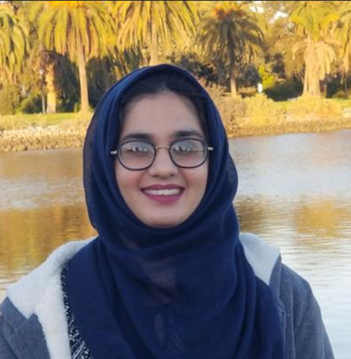

Age and Gender Estimation using Deep Learning
Group Members: -
Hafiza Rimsha Rauf
Yashdeep Singh

Slide 3
1.
Problem Statement
Why?
‹#›

Slide 4



Why?
Access Control
Human Computer Interaction
Surveillance
Public Interest in Apparent Age
‹#›

Slide 5
2.
DataSet
What?
‹#›

Slide 6
IMDb-Wiki
& UTKFace
DataSets

Slide 7
62,328
20,000+
Images in Wiki dataset
Images in UTKFace
22138+9780
Face images combined
Notes:
Around 32k face images

Slide 8
How?
Data Preprocessing
Parse labels from the filename
Only images with age<=100
Removed images without labels
Removed images with no faces
Reshape images
first

Slide 9
Face Detection
first
second
‹#›

Slide 10

Face Detection
‹#›

Slide 11
Image Classification
third
first
second
‹#›

Slide 12
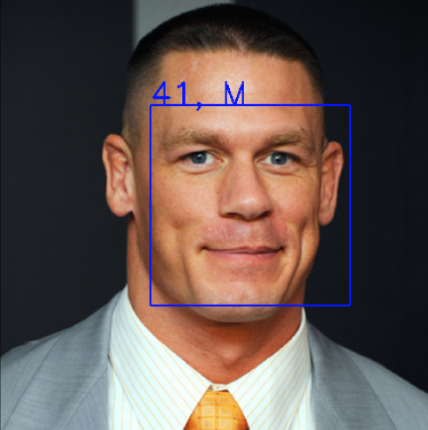
Image Classification
43, M
“You can’t see me”
‹#›

Slide 13
3.
Implementation
How?
‹#›

Slide 14
Methodology
Comparative Study:
VGG and Wide-Resnet Architecture Differences
Model Performance for Age and Gender Estimation on Validation Data(Wiki) and Unseen Data(UTKF)
Effect of Random Erasing
Effect of Random Shifts
‹#›

Slide 15
Comparative Study
VGG-Face Architecture
Rasmus Rothe, Radu Timofte, Luc Van, Gool Computer Vision Lab, D-ITET, ETH Zurich, Switzerland
22 layers
Image Input Shape = (224,224,3)
Two separate models trained for Age and Gender Classification
‹#›

Slide 16
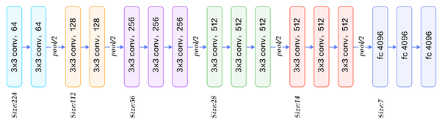
VGG-Face Architecture (22 Layers in Depth)
1x1 conv, 101
1x1 conv, 2
Softmax
Softmax
‹#›

Slide 17
Comparative Study
Wide Resnet Architecture
Zagoruyko, Sergey and Komodakis, Nikos, Proceedings of the British Machine Vision Conference 2016
16 Layer in Depth and and Wide Residual Blocks
Uses Skip Connections
Image Input Shape = (64,64,3)
A joint model trained for Age and Gender Classification simultaneously

Slide 18
Wide ResNet Architecture (16 Layers in Depth and Wide Residual Blocks)
3x3 conv,16
3x3 conv,128
3x3 conv,128
3x3 conv,128
3x3 conv,128
3x3 conv,128
3x3 conv,128
3x3 conv,128
3x3 conv,256
3x3 conv,256
3x3 conv,256
3x3 conv,256
3x3 conv,256
3x3 conv,512
3x3 conv,512
3x3 conv,512
3x3 conv,512
Average Pooling
Flatten
Softmax
Softmax
Age (101) Gender(2)
‹#›

Slide 19
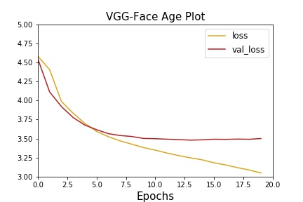
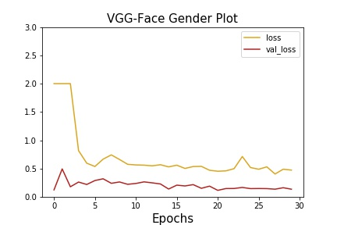
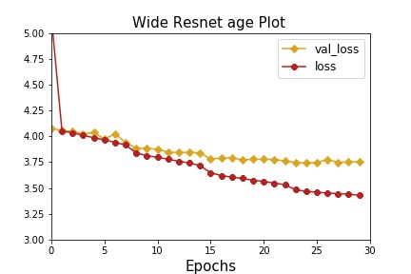
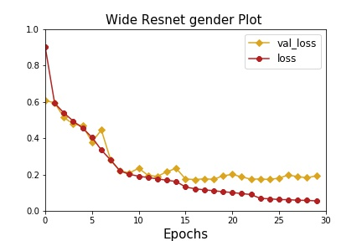
Model Training + Tuning on Wiki Dataset
‹#›

Slide 20
4.
Results
‹#›

Slide 21
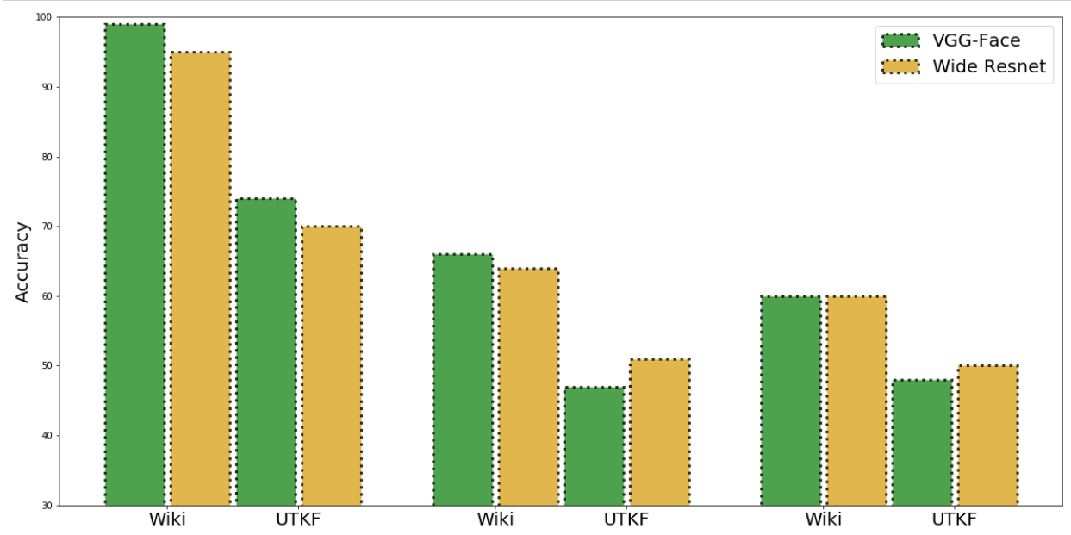
Gender Prediction Results
Aligned Face Images
Randomly flipped Images
Randomly Erased Images

Slide 22
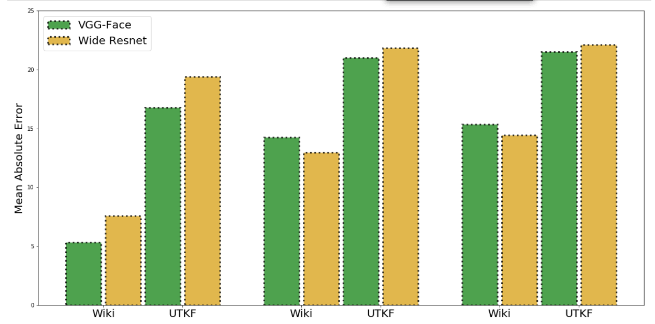
Age Prediction Results
Aligned Face Images
Randomly flipped Images
Randomly Erased Images

Slide 23
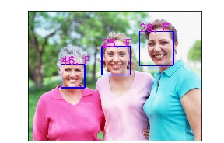
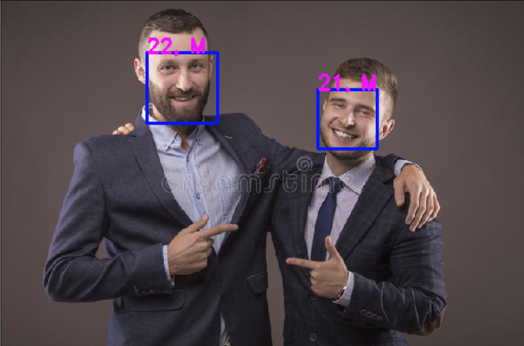
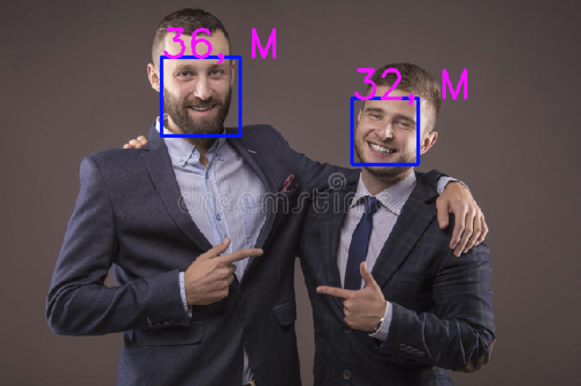
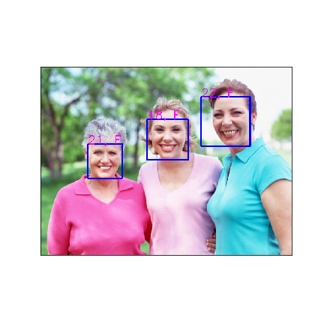
Age Group Wise Analysis
Wide ResNet seems to better for people with age group (50+)
VGG-Face Architecture seems to better for people with age group (0,40)
VGG
Wide Resnet
‹#›

Slide 24
Conclusion
VGG-Face Architecture overall performs better for both seen(WIKI) and unseen(UTKF) data
Processing time of Wide Resnet is much faster due to smaller input image size
Effect of Random Erase and Random Rotations :-
VGG-Face
Gender accuracy is dropped by 33-90%
Age accuracy is dropped by 10-11%
Wide Resnet
Gender accuracy is dropped by 28-32%
Age accuracy is dropped by 4-8%
WideResNet performs better for olders
VGG Performs better for youngsters
‹#›

Slide 25
5.
Demo
‹#›

Slide 26
Demo

Slide 27
Thanks!
Any questions?

